Slide 1
Dimensionality Reduction (Contd)
CS771: Introduction to Machine Learning
Piyush Rai

Slide 2
Plan
A fast method for computing eigenvectors (power method)
Supervised dimensionality reduction
Nonlinear dimensionality reduction
Kernel PCA
Manifold Learning (LLE and SNE/tSNE)

Slide 3
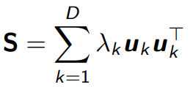
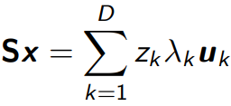
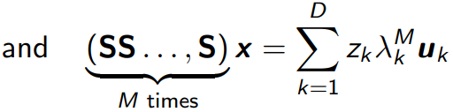
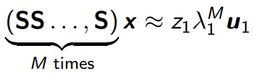
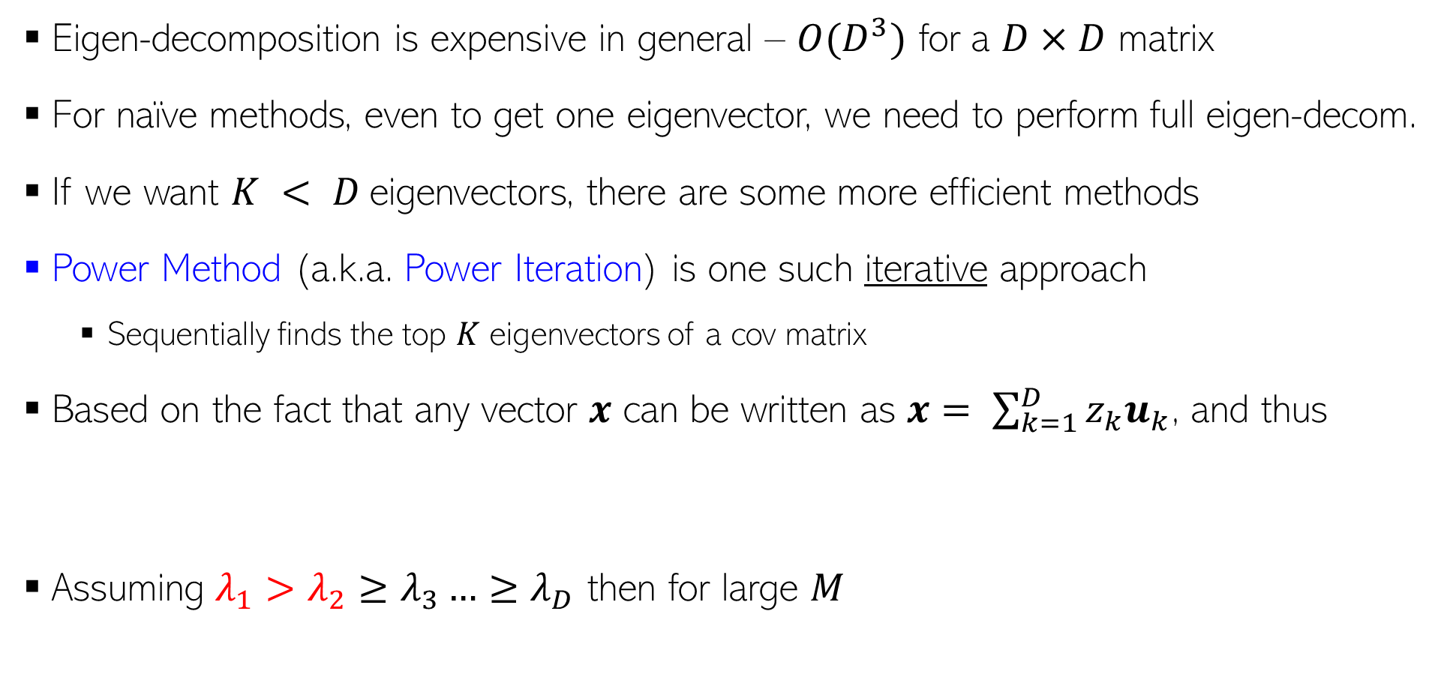
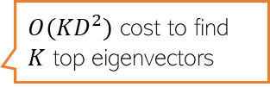
Power Method for Computing Eigenvectors
Eigen-decomposition is expensive in general – $O(D^{3})$ for a $D×D$ matrix
For naïve methods, even to get one eigenvector, we need to perform full eigen-decom.
If we want $K < D$eigenvectors, there are some more efficient methods
Power Method (a.k.a. Power Iteration) is one such iterative approach
Sequentially finds the top $K$ eigenvectors of a cov matrix
Based on the fact that any vector $x$ can be written as $x= \sum_{k=1}^{D}{z_{k}u_{k}}$, and thus
Assuming $λ_{1}>λ_{2}≥λ_{3}…{≥λ}_{D}$ then for large $M$
$O({KD}^{2})$ cost to find $K$ top eigenvectors

Slide 4
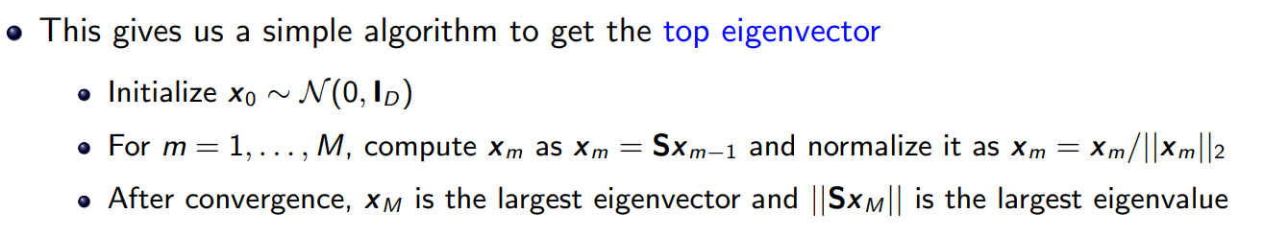
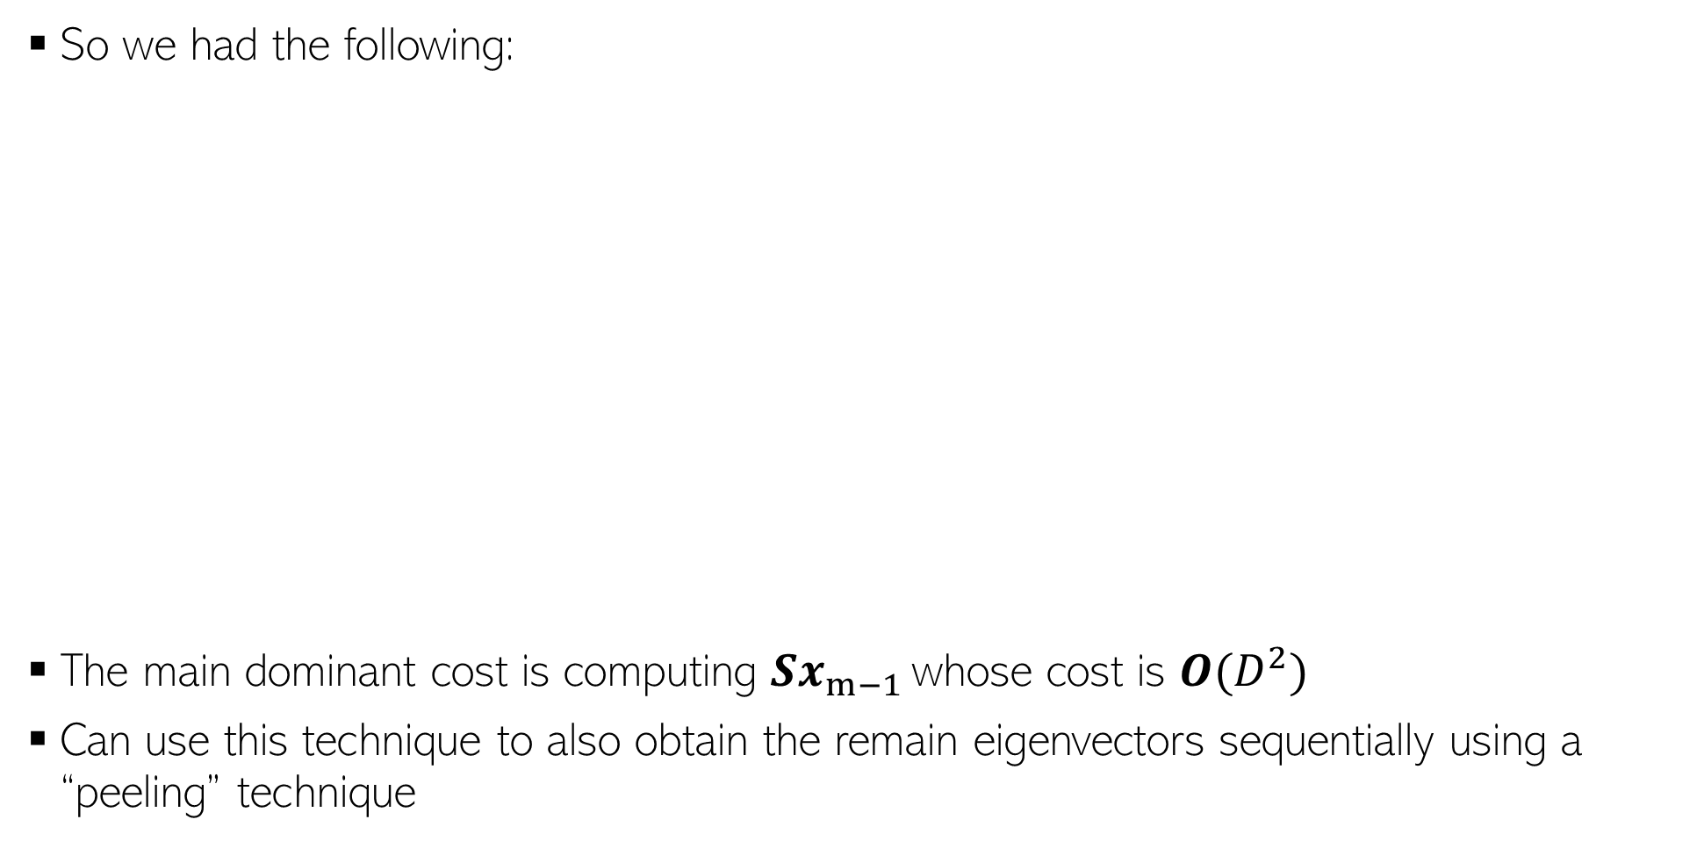

Power Method for Computing Eigenvectors
So we had the following:
The main dominant cost is computing $Sx_{m−1 }$whose cost is $O(D^{2})$
Can use this technique to also obtain the remain eigenvectors sequentially using a “peeling” technique
Since eigenvectors should have unit norm
Using the fact $Sx =λx$ and that $x$ has unit norm

Slide 5
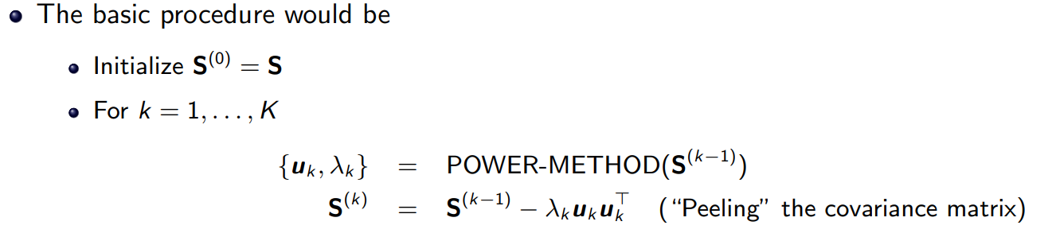


Power Method with Peeling Technique
Can use Power Method with a “peeling” technique to get all the top $K$ eigenvectors
Each power iteration is $O(D^{2})$, overall cost for getting $K$ eigenvectors is $O(KD^{2})$
$$\sum_{k=1}^{D}{λ_{k}u_{k}u_{k}^{⊤}}$$

Slide 6
Supervised Dimensionality Reduction
Maximum variance directions may not be aligned with class separation directions
Be careful when using PCA for supervised learning problems
A better option would be to project such that
Points within the same class are close (low intra-class variance)
Points from different classes are well separated (the class means are far apart)
Direction that preserves class separation
Projecting along this will give a one dimensional embedding of each point with both classes overlapping with each other
Projecting along this will give a one dimensional embedding of each point with both classes still having a good separation
Max variance direction (given by PCA)

Slide 7
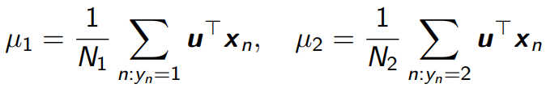



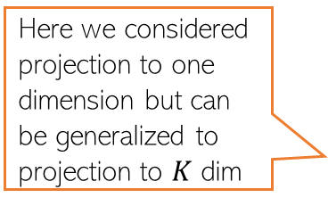
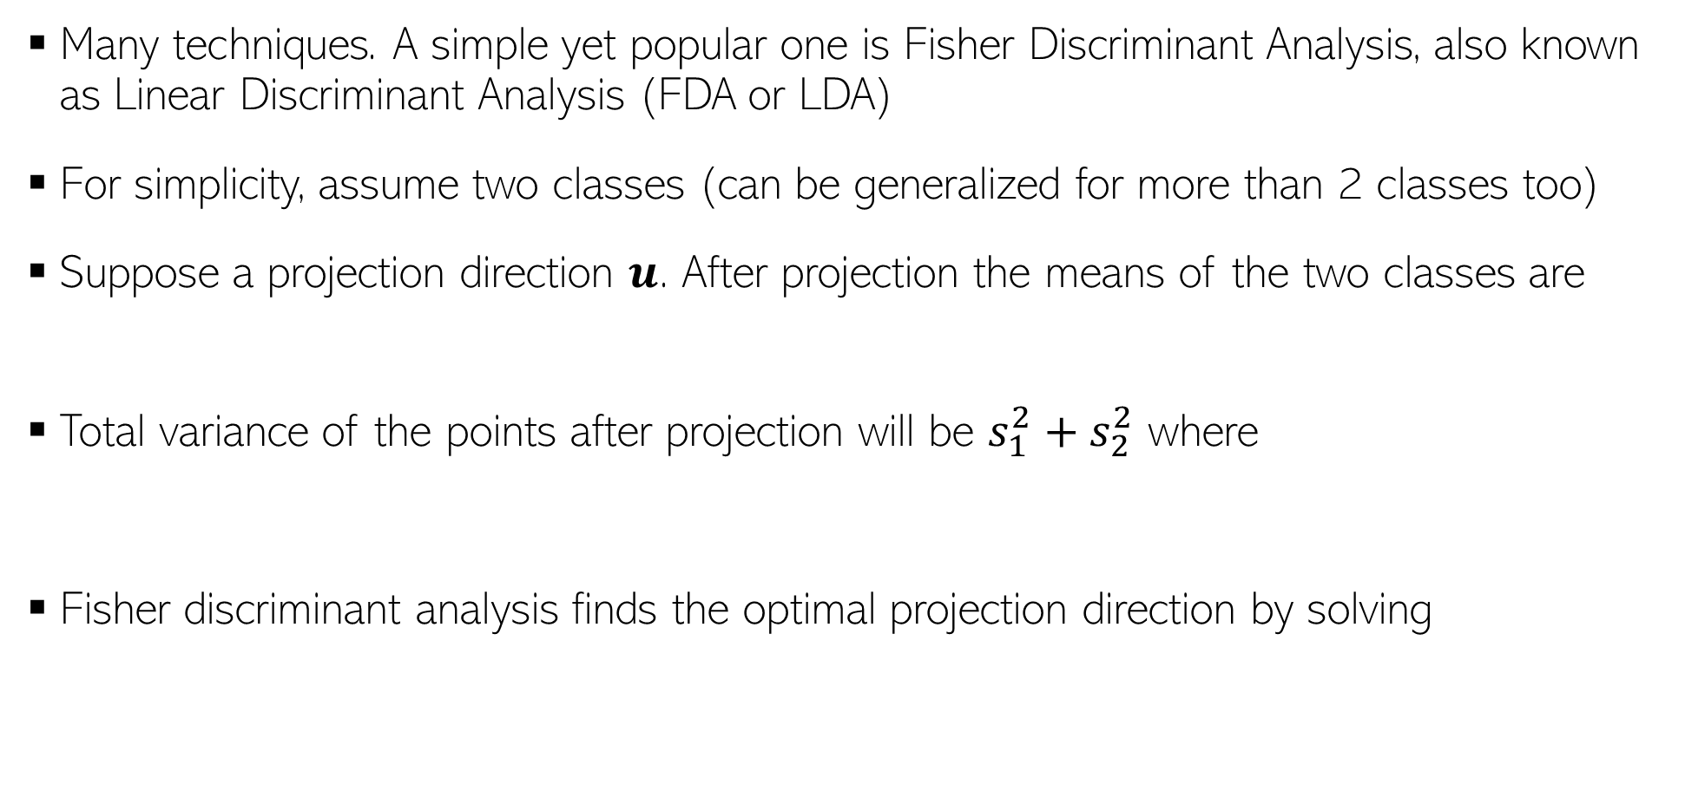
Supervised Dimensionality Reduction
Many techniques. A simple yet popular one is Fisher Discriminant Analysis, also known as Linear Discriminant Analysis (FDA or LDA)
For simplicity, assume two classes (can be generalized for more than 2 classes too)
Suppose a projection direction $u$. After projection the means of the two classes are
Total variance of the points after projection will be $s_{1}^{2}+s_{2}^{2}$ where
Fisher discriminant analysis finds the optimal projection direction by solving
This LDA should not be confused with another very popular ML technique for finding topics in text data (Latent Dirichlet Allocation)
Here we considered projection to one dimension but can be generalized to projection to $K$ dim
The solution to this problem involves solving an eigendecomposition problem that involves within class covariance matrices and between class covariance matrices
Push the means far apart
Make each class tightly packed after projection (small variance)

Slide 8
Dimensionality Reduction given Pairwise Distances between points

Slide 9
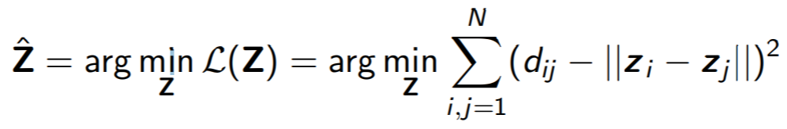
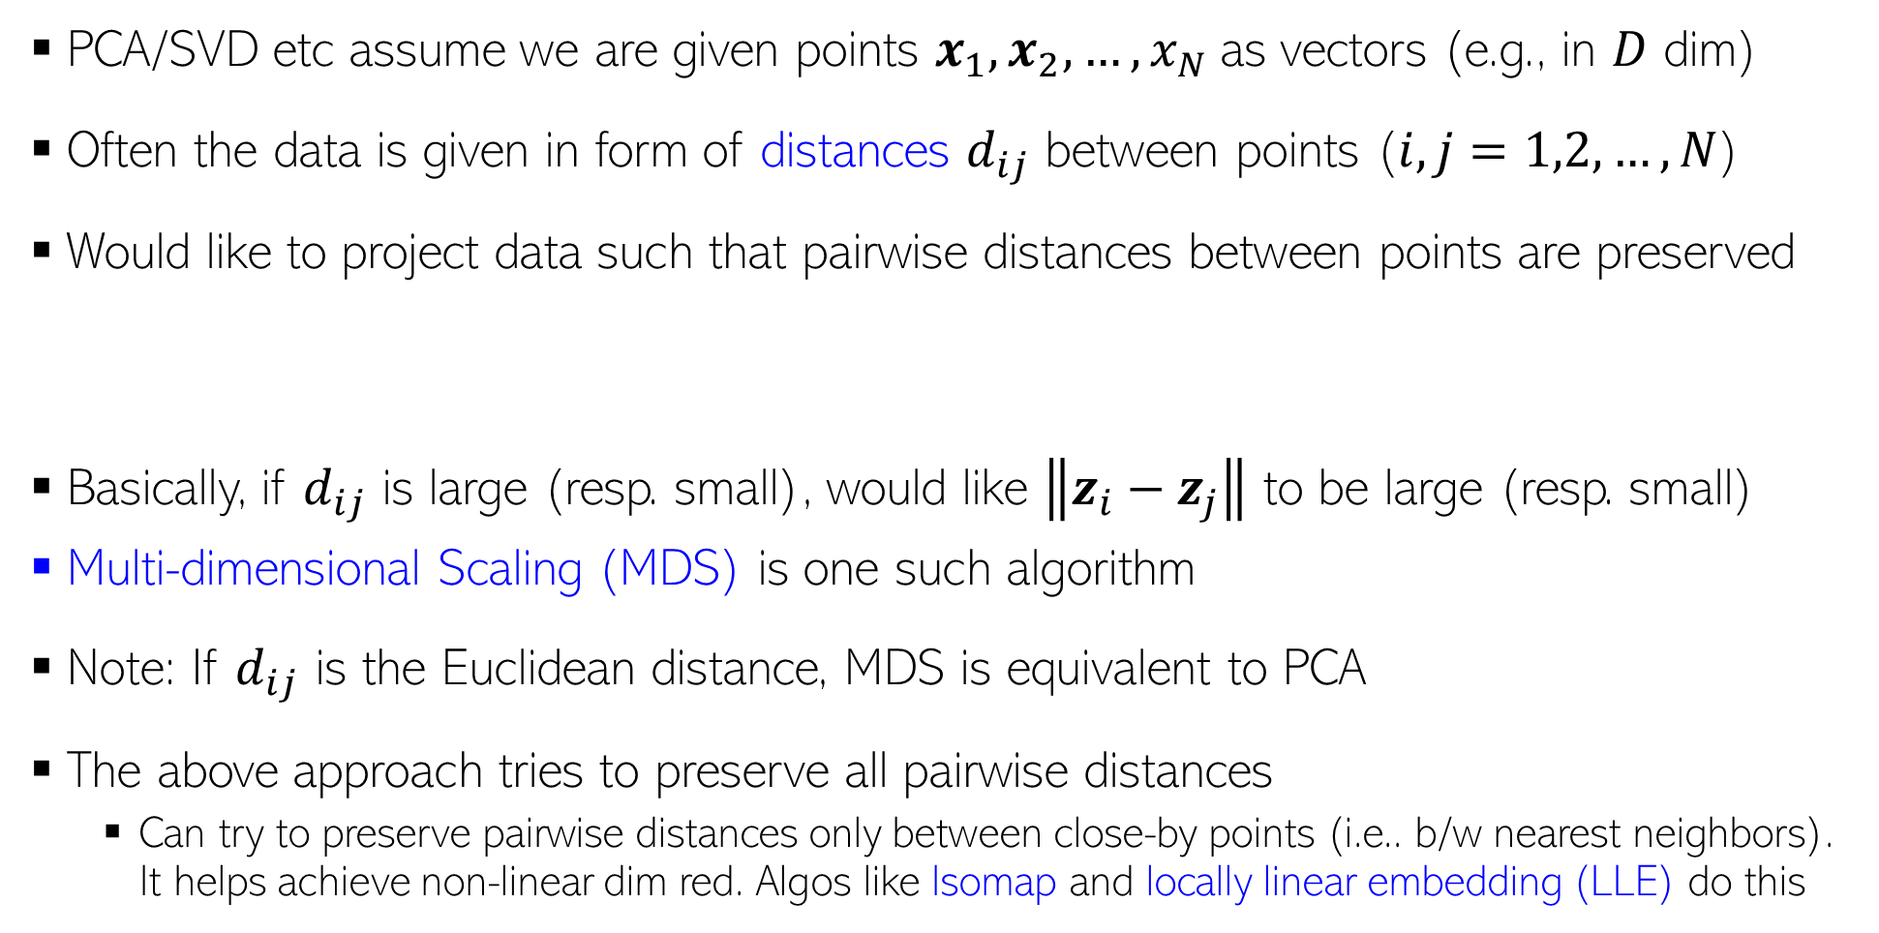
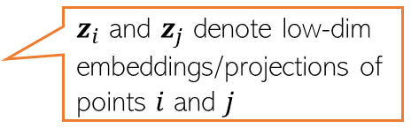
Dim. Reduction by Preserving Pairwise Distances
PCA/SVD etc assume we are given points $x_{1}, x_{2},…, x_{N}$as vectors (e.g., in $D$ dim)
Often the data is given in form of distances $d_{ij}$ between points ($i,j=1,2,…,N$)
Would like to project data such that pairwise distances between points are preserved
Basically, if $d_{ij}$ is large (resp. small), would like $\left\|z_{i}−z_{j}\right\|$ to be large (resp. small)
Multi-dimensional Scaling (MDS) is one such algorithm
Note: If $d_{ij}$ is the Euclidean distance, MDS is equivalent to PCA
The above approach tries to preserve all pairwise distances
Can try to preserve pairwise distances only between close-by points (i.e.. b/w nearest neighbors). It helps achieve non-linear dim red. Algos like Isomap and locally linear embedding (LLE) do this
$z_{i}$ and $z_{j}$ denote low-dim embeddings/projections of points $i$ and $j$

Slide 10
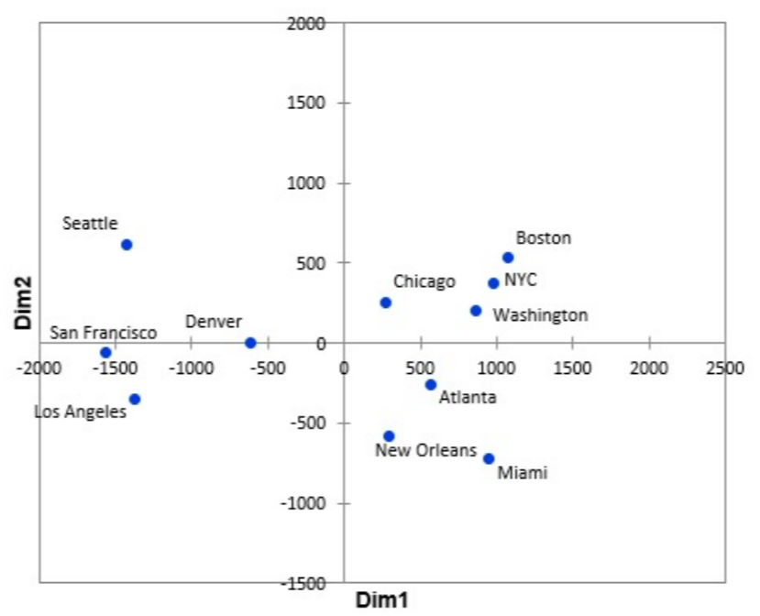
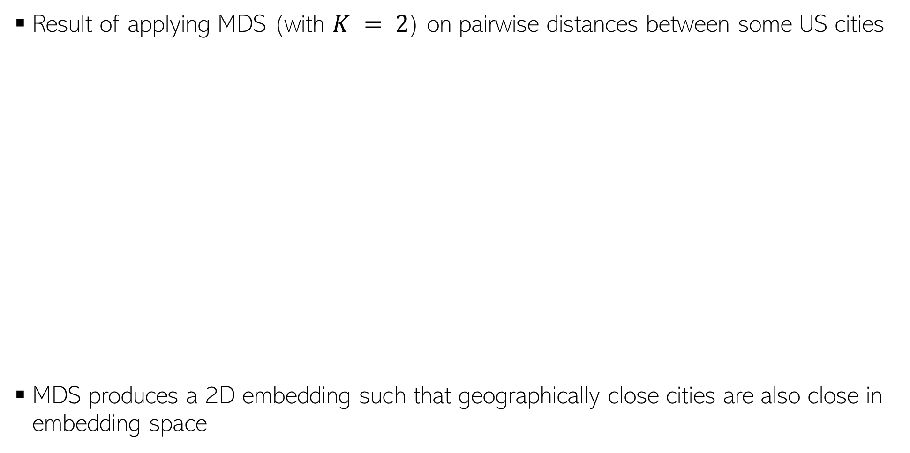
MDS: An Example
Result of applying MDS (with $K = 2$) on pairwise distances between some US cities
MDS produces a 2D embedding such that geographically close cities are also close in embedding space

Slide 11
Nonlinear Dimensionality Reduction

Slide 12
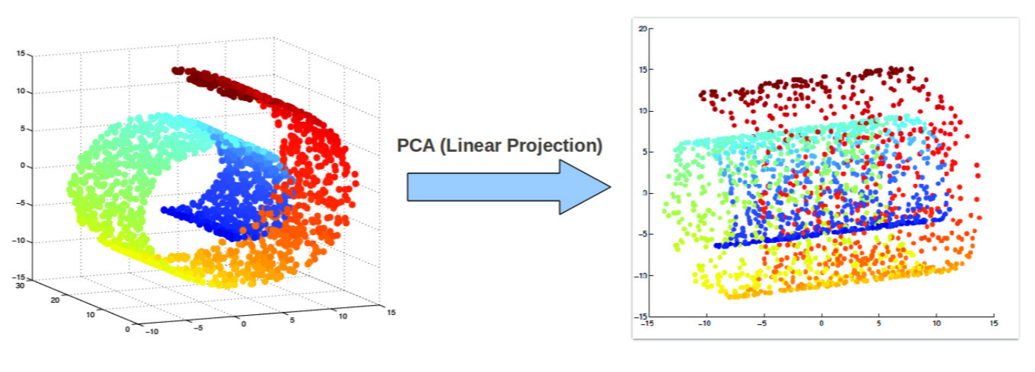
Beyond Linear Projections
Consider the swiss-roll dataset (points lying close to a manifold)
Linear projection methods (e.g., PCA) can’t capture intrinsic nonlinearities
Maximum variance directions may not be the most interesting ones
Relative positions of points destroyed after the projection

Slide 13
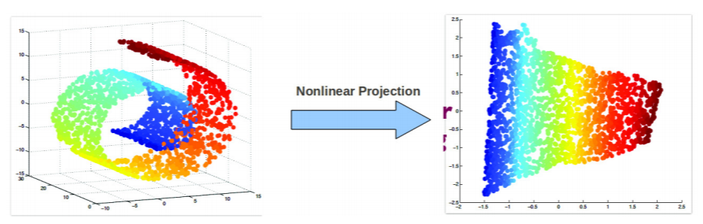
Nonlinear Dimensionality Reduction
We want to a learn nonlinear low-dim projection
Some ways of doing this
Nonlinearize a linear dimensionality reduction method. E.g.:
Cluster data and apply linear PCA within each cluster (mixture of PCA)
Kernel PCA (nonlinear PCA)
Using manifold based methods that intrinsically preserve nonlinear geometry, e.g.,
Locally Linear Embedding (LLE), Isomap
Maximum Variance Unfolding
Laplacian Eigenmap, and others such as SNE/tSNE, etc.
.. or use unsupervised deep learning techniques (later)
Relative positions of points preserved after the projection
Will look at KPCA, LLE, SNE/tSNE

Slide 14
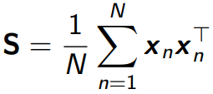

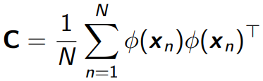



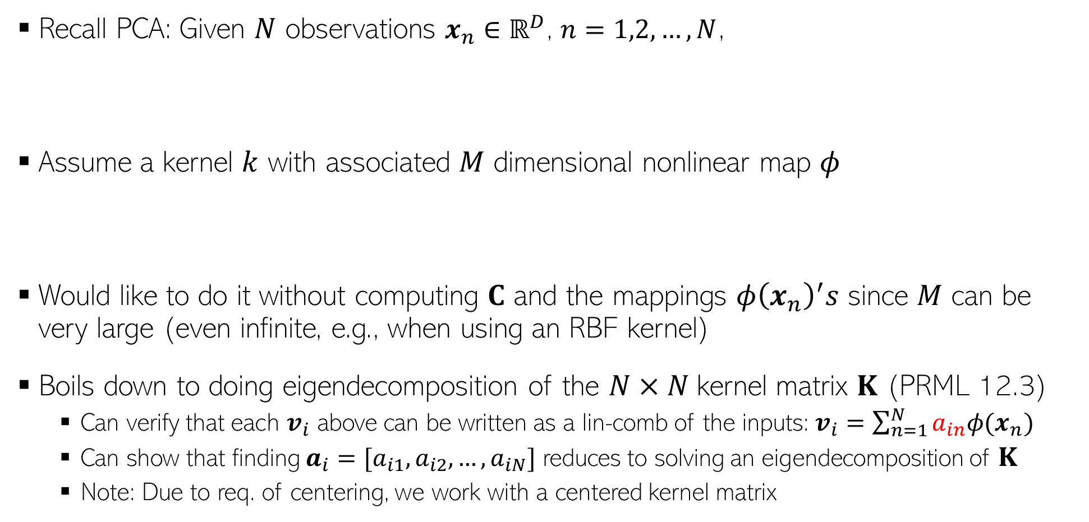
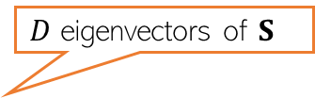

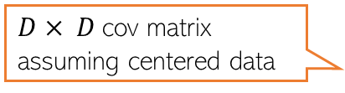
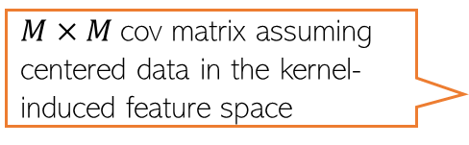
Kernel PCA
Recall PCA: Given $N$ observations $x_{n}∈ℝ^{D}$, $n=1,2,…,N$,
Assume a kernel $k$ with associated $M$ dimensional nonlinear map $φ$
Would like to do it without computing $C$ and the mappings $φ{\left(x_{n}\right)}^{′}s$ since $M$ can be very large (even infinite, e.g., when using an RBF kernel)
Boils down to doing eigendecomposition of the $N×N$kernel matrix $K$ (PRML 12.3)
Can verify that each $v_{i}$ above can be written as a lin-comb of the inputs: $v_{i}=\sum_{n=1}^{N}{a_{in}φ(x_{n})}$
Can show that finding $a_{i}=[a_{i1},a_{i2},…, a_{iN}]$ reduces to solving an eigendecomposition of $K$
Note: Due to req. of centering, we work with a centered kernel matrix
$D$ eigenvectors of $S$
$D× D$cov matrix assuming centered data
$M×M$cov matrix assuming centered data in the kernel-induced feature space
$M$ eigenvectors of $C$
$N×N$matrix of all 1s

Slide 15
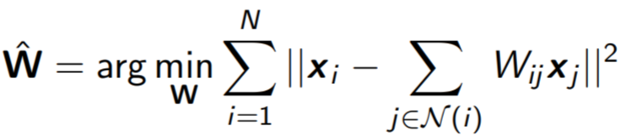
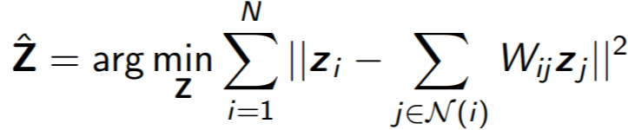
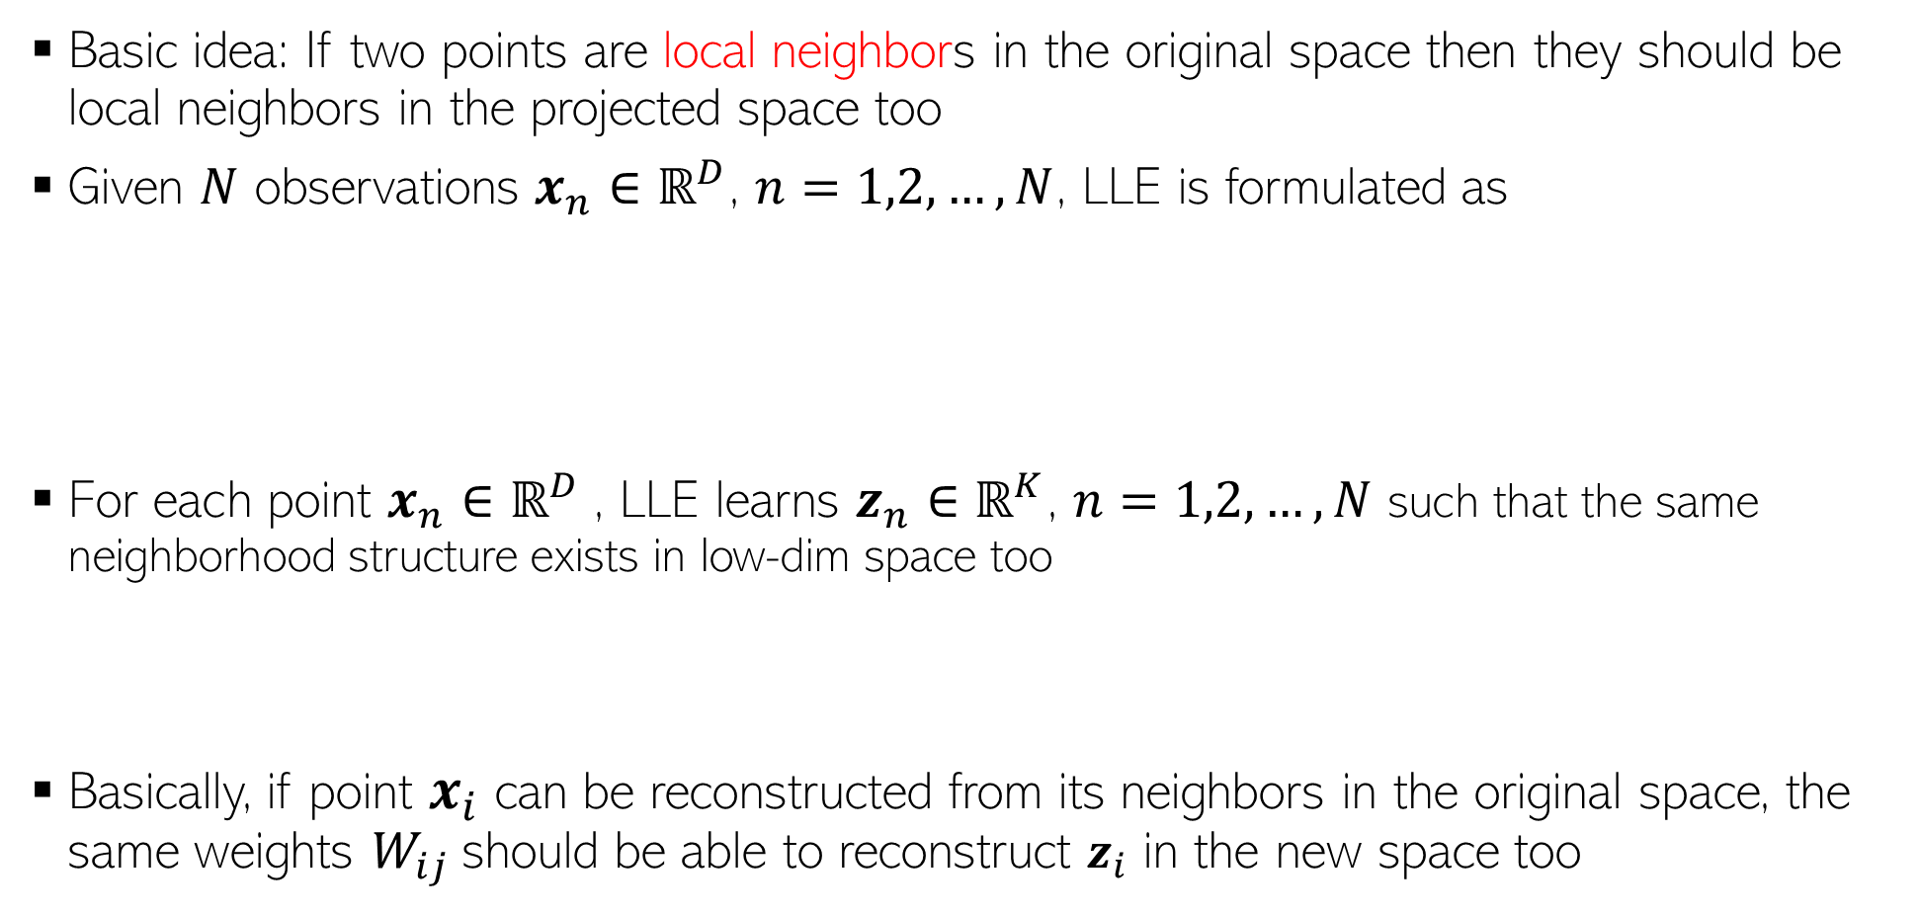
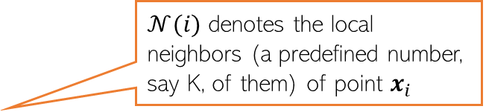
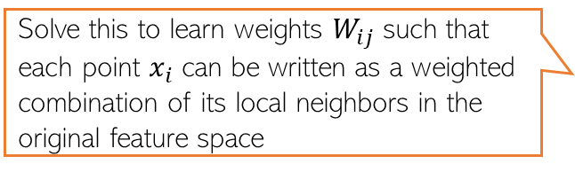
Locally Linear Embedding
Several non-lin dim-red algos use this idea
Essentially, neighbourhood preservation, but only local
Basic idea: If two points are local neighbors in the original space then they should be local neighbors in the projected space too
Given $N$ observations $x_{n}∈ℝ^{D}$, $n=1,2,…,N$, LLE is formulated as
For each point $x_{n}∈ℝ^{D}$, LLE learns $z_{n}∈ℝ^{K}$, $n=1,2,…,N$ such that the same neighborhood structure exists in low-dim space too
Basically, if point $x_{i}$ can be reconstructed from its neighbors in the original space, the same weights $W_{ij}$should be able to reconstruct $z_{i}$ in the new space too
Solve this to learn weights $W_{ij}$such that each point $x_{i}$ can be written as a weighted combination of its local neighbors in the original feature space
$𝒩(i)$ denotes the local neighbors (a predefined number, say K, of them) of point $x_{i}$
Requires solving an eigenvalue problem
S. T. Roweis and L. K. Saul. Nonlinear dimensionality reduction by locally linear embedding. Science 290 (2000)

Slide 16
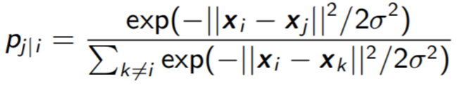
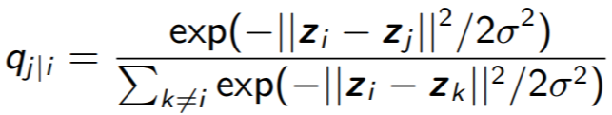
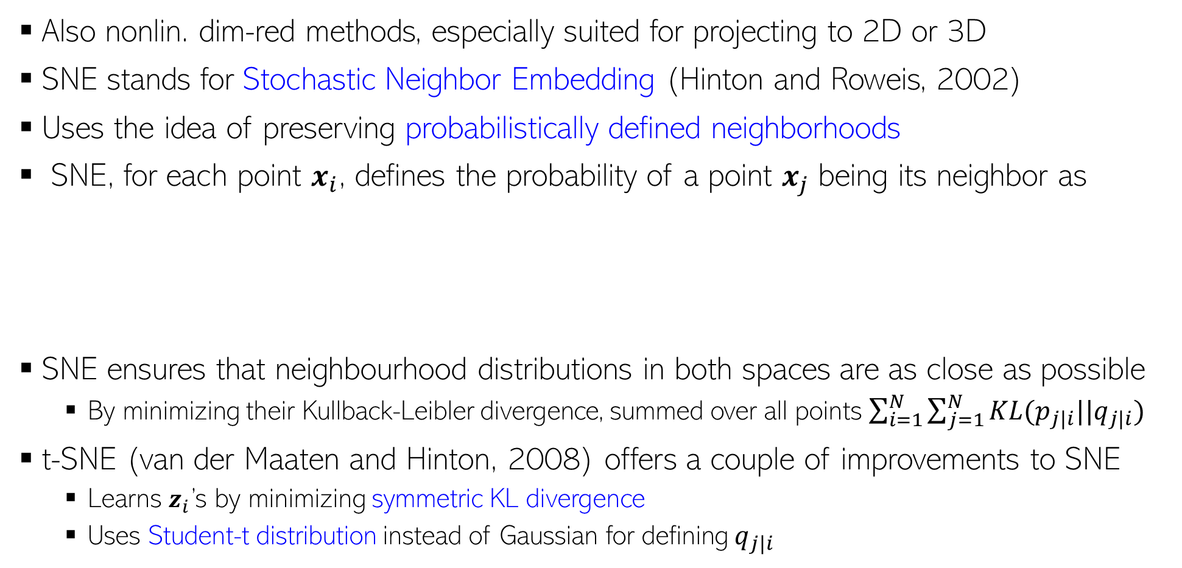
SNE and t-SNE
Thus very useful if we want to visualize some high-dim data in two or three dims
Also nonlin. dim-red methods, especially suited for projecting to 2D or 3D
SNE stands for Stochastic Neighbor Embedding (Hinton and Roweis, 2002)
Uses the idea of preserving probabilistically defined neighborhoods
SNE, for each point $x_{i}$, defines the probability of a point $x_{j}$ being its neighbor as
SNE ensures that neighbourhood distributions in both spaces are as close as possible
By minimizing their Kullback-Leibler divergence, summed over all points $\sum_{i=1}^{N}{\sum_{j=1}^{N}{KL(p_{j|i}||q_{j|i})}}$
t-SNE (van der Maaten and Hinton, 2008) offers a couple of improvements to SNE
Learns $z_{i}$’s by minimizing symmetric KL divergence
Uses Student-t distribution instead of Gaussian for defining $q_{j|i}$
Neighbor probability in the original space
Neighbor probability in the projected/embedding space

Slide 17
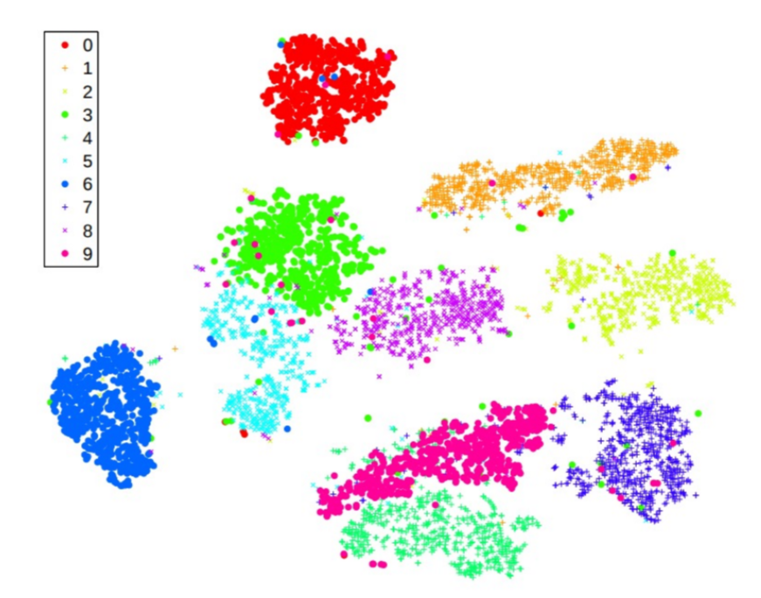
SNE and t-SNE
Especially useful for visualizing data by projecting into 2D or 3D
Result of visualizing MNIST digits data in 2D (Figure from van der Maaten and Hinton, 2008)

